Slide 1
KNYPERSLEY FIRST SCHOOL
Welcome to Year 2
2025

Slide 2
What We'll Discuss today
School website
Attendance
Behaviour Policy
Communication
SEND support
Yearly Overviews
How to support at home
Exciting Events
Reminders

Slide 3
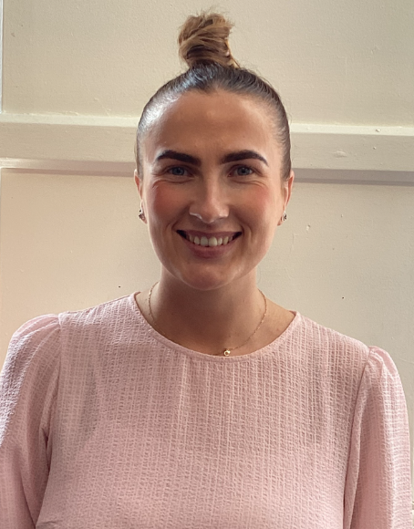
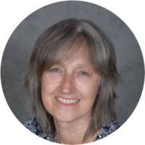
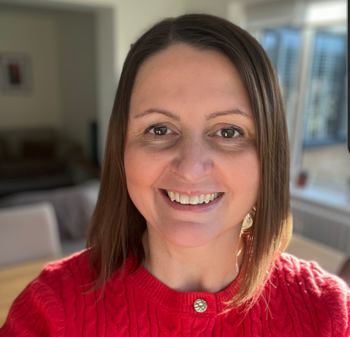
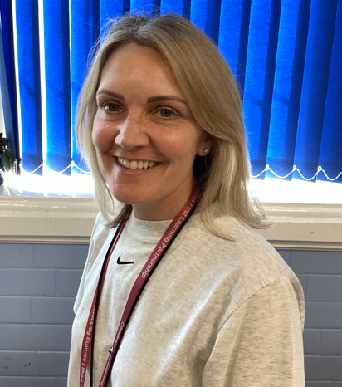
Introduction to The Year 2 Team
Miss Emery – Class 4 Teacher
Mrs Johnson – Class 4 Teaching Assistant
Mrs Harvey – Class 5 Teacher
Mrs Porter– Class 5 Teaching
Assistant

Slide 4
School Website
http://knypersley.staffs.sch.uk/
Policies
Newsletter - Online/ via Arbor (paper copies available via the school office).
E-Safety Guidance
Safeguarding page
PTFA information
School Calendar

Slide 5
Communication
We value your communication and feel that it is important that everyone feels heard and valued within our school community.
Below is an outline our the channels of communication within our school:
Arbor
Weekly Drop-in
Arbor is our main platform for direct communication for staff and parents. Arbor messages are check before school and after school by staff between the hours of 8:30-5:30pm. Mrs Taylor in the office checks Arbor frequently throughout the day. Please use Arbor for non-urgent messages, clubs and parent’s evening appointments.
Beyond the formal parents meeting events noted above, our school has always offered a night during every school week where staff are available to answer any questions you may have or to address any concerns which may have arisen. These sessions are between 3.30- 4p.m
Year 2 drop-in will be on a Wednesday
Main Office
Reports/ Parents Evenings.
Please call the school office 01782 973810 to pass on urgent time limted messages for example-informing us that your child is absent, booking your child into Kid Zone (due to an emergency). Please be mindful that this is NOT for non-urgent messages that could be passed on by staff at the door.
Reports are sent three times a year at the end of every term. Parent’s Evenings are then run twice a year at the end of Autumn and Spring half terms in order for staff to inform you of successes and next steps.
Parent’s evenings can be book via Arbor.

Slide 6
Attendance
Attendance is tracked daily
It is of the up-most importance that you report absences. This is to support our safeguarding procedures
Forming good habits
Supports progress
Increased wellbeing
Supports to build friendships
Holiday request forms can be collected from the school office. We encourage you to avoid taking holidays within school time.

Slide 7
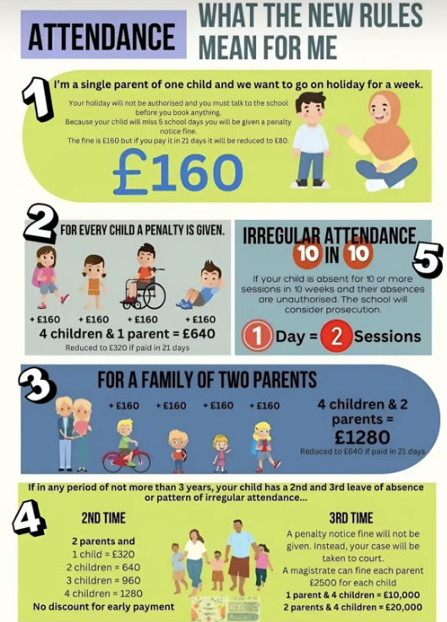
Attendance
Forming good habits
Supports progress
Increased wellbeing
Supports to build friendships

Slide 8
Positive behaviour management
https://www.knypersley.staffs.sch.uk/wp-content/uploads/2023/08/Knypersley-Positive-Behaviour-Policy-23-24-5.pdf
Our 3B rules are consistent from nursery to Year 4 which supports children in understanding expectations for behaviour.
Each class starts the year by writing their own class 3B expectations which develop over the years as they do themselves.
Our Positive Behaviour Policy is based upon restorative conversations and practice. Ensuring all children use mistakes as a chance to learn and better themselves.
Parents are notified if their child reaches a ‘red card’. This will mean that your child has needed multiple reminders and have not been able to follow the 3Bs over a period of time.
If your child reaches ‘WOW’ this is down to them following the 3B expectations consistently enough to reach a reward. Moving to WOW is not done due to a one off event or learning achievement.

Slide 9
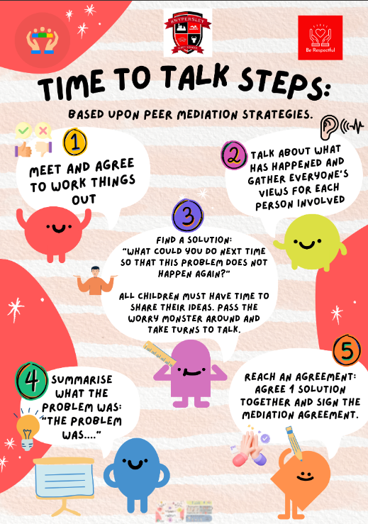
Social, Emotional and Mental Health
Forming good habits
Supports progress
Increased wellbeing
Supports to build friendships

Slide 10
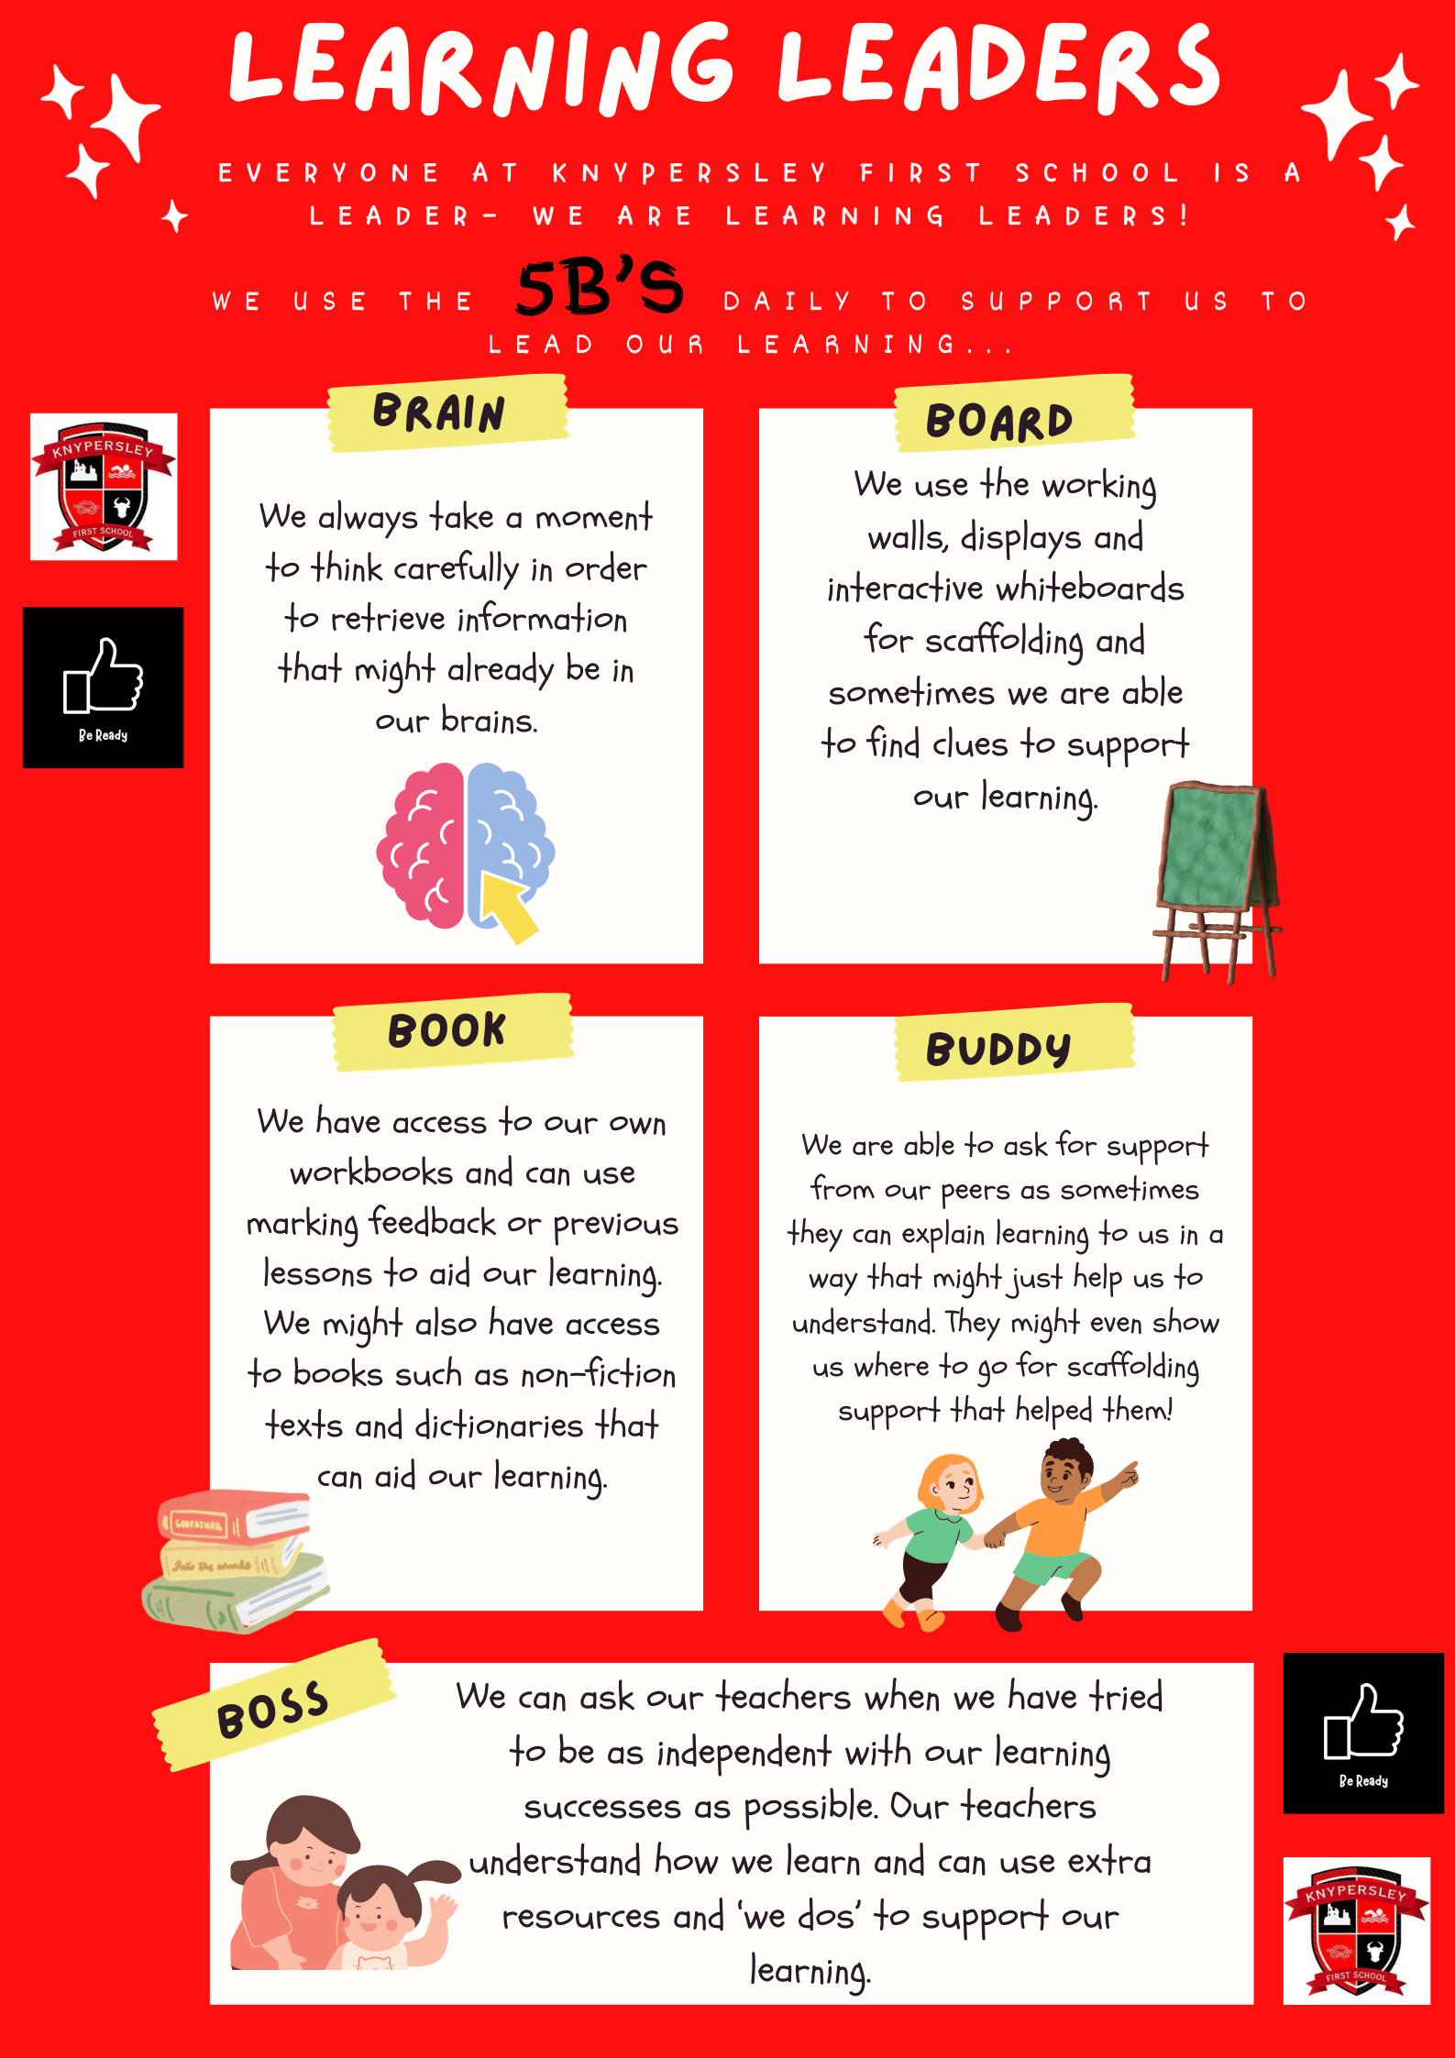
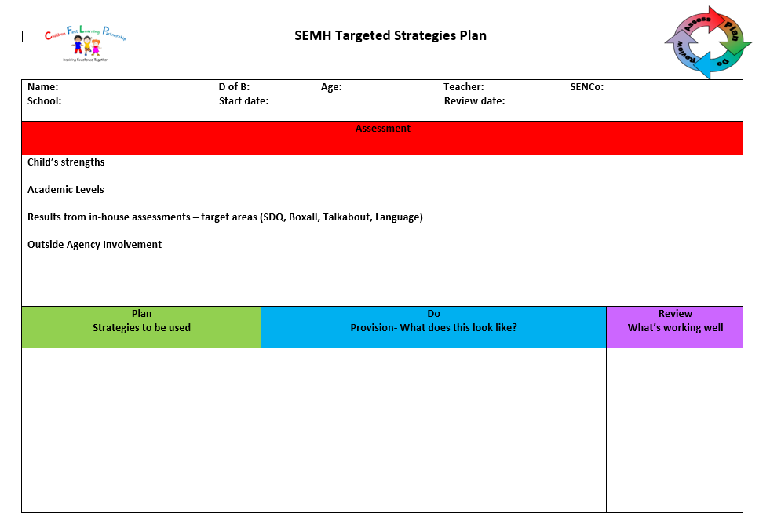
Behaviours for learning
2. The World We Live In

Slide 11
Class Webpages/ Curriculum overviews
Our year group page hosts a wealth of information that staff refer to throughout the year such as:
Curriculum Overviews - Overview of learning over the year. This is a great way to pre-teach or to engage with learning theme's as your child is immersed within them in school.
Class Webpages
Curriculum drivers i.e. Careers Week, Faith in Focus Etc.
Specific subject curriculum areas.
2. The World We Live In

Slide 12
Reading
Children will be heard read by an adult at least once a week.
There will also be reading in Good Morning Work , sometimes with a reading buddy.
In Year 2, children revisit Phase 5 phonics (Little Wandle) daily and take part in reading sessions just like in Year 1.
From October, children will take part in ERIC sessions three times a week, to promote the joy of reading and to teach specific age related reading skills.
The focus in Year 2 is reading with fluency, prosody and being able to comprehend what is being read.
To promote a love of reading, we will visit our school library each week to select a book to share.
2. The World We Live In

Slide 13
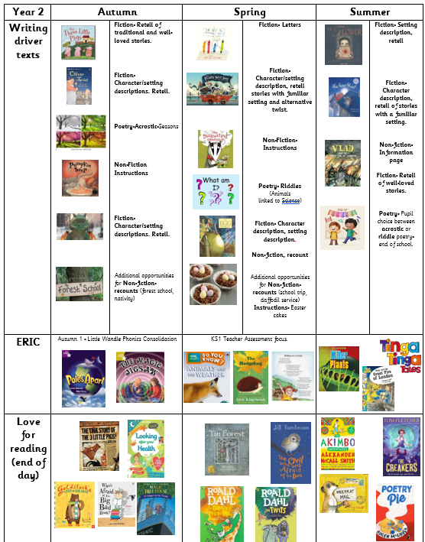
Writing in year 2
In Year 2, the main focus of our English lessons will be to add greater detail to different types of sentences and use a range of openers and conjunctions such as 'and, because, so and if'. We will enjoy lots of fabulous stories to inspire our writing and gather lots of high-level language.
2. The World We Live In

Slide 14
Spelling
Children receive daily spelling lessons that focus on year group specific spelling rules.
Spelling of the common exception words is a big focus across the school.
Children will also have a login for The Spelling Shed to use at home, with games that link to their spelling words. We will update these every Friday following in-class assessments.
2. The World We Live In

Slide 15
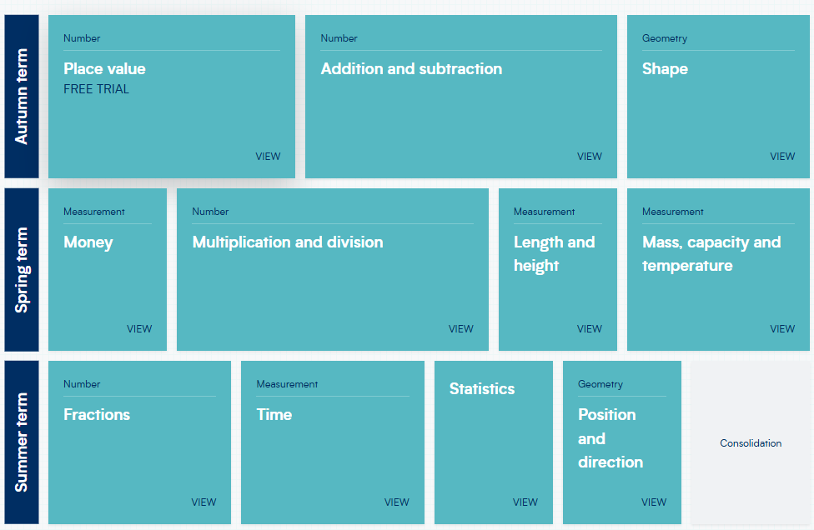
Maths
The children are given lots of opportunities to explore new maths learning through discussions with partners and in groups; using equipment to support their understanding.
We encourage the children to represent their working out using concrete resources, pictorially, using abstract methods and then demonstrate their depth of understanding when exploring reasoning and problem-solving challenges.
In year 2, the children are encouraged to know their number facts to 100.
2. The World We Live In

Slide 16
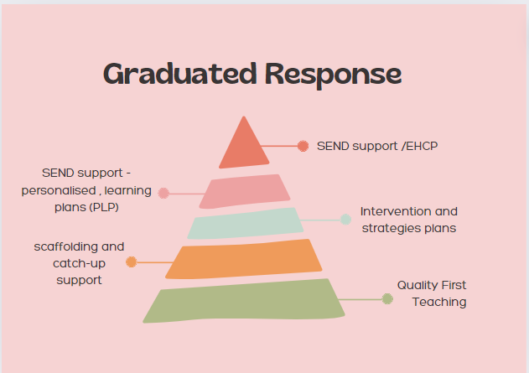
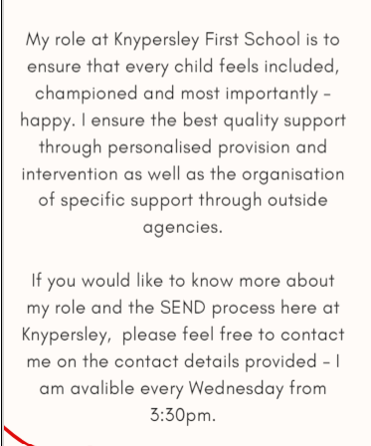
SEND support AT Knypersley First School
https://www.knypersley.staffs.sch.uk/special-educational-needs-and-disabilities/

Slide 17
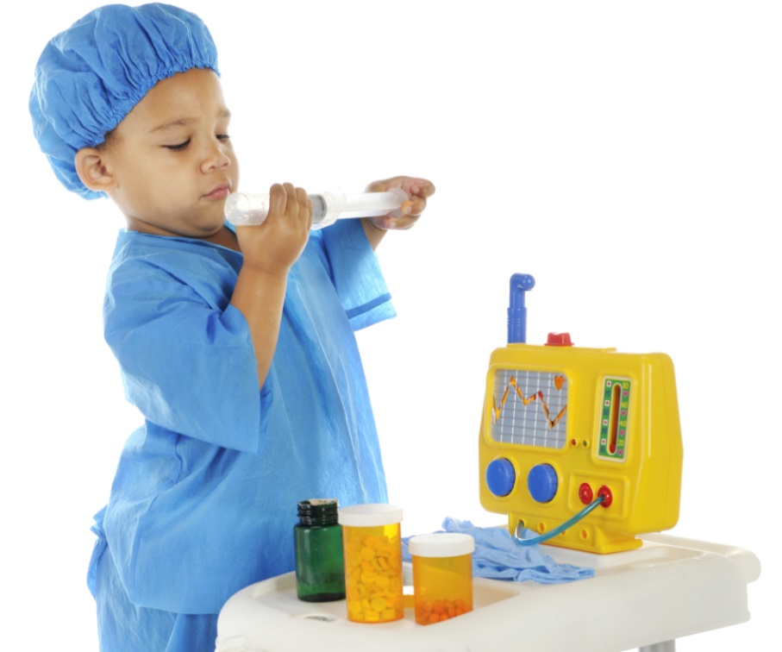
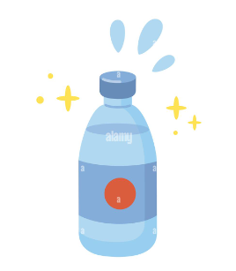
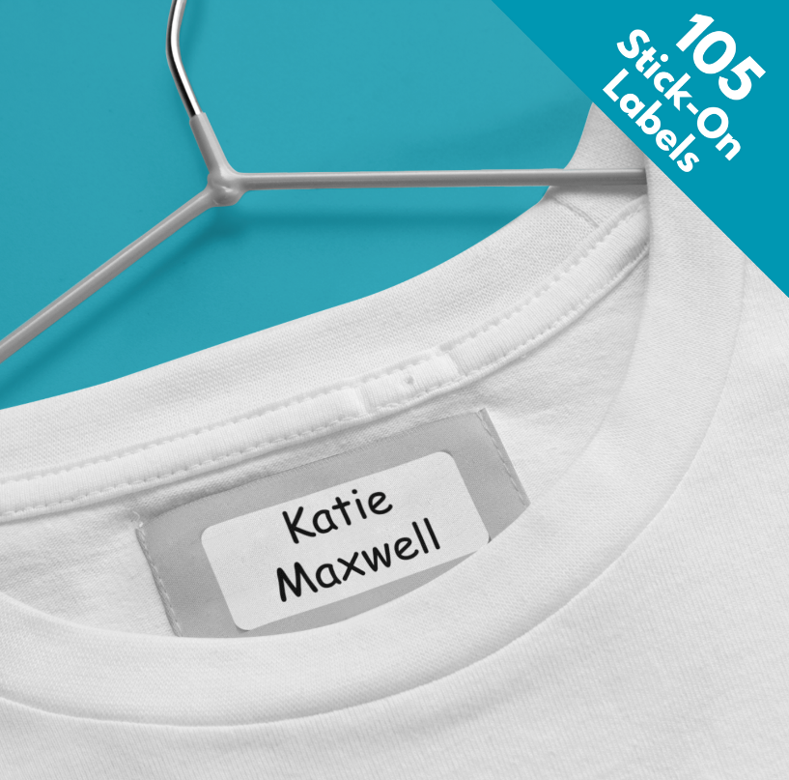
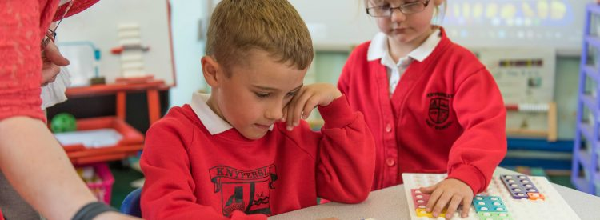
Year 2 Essentials
We are a healthy school and promote water in bottles and healthy lunchboxes. Please speak to a member of staff if you require support with this.
We are a nut free setting due to allergies identified. Thank you for your support with this.
Please can all medication be signed into school via the main office. No medicine will be accepted on the door.
Year 2 Uniform:
Red jumper or cardigan
White Polo Top
Black or grey skirt or trousers
Black shoes
All uniform is required to be the same therefore items can be swapped or misplaced. Please support staff in returning items by clearly labelling all items including bottles, hats, coats etc.

Slide 18
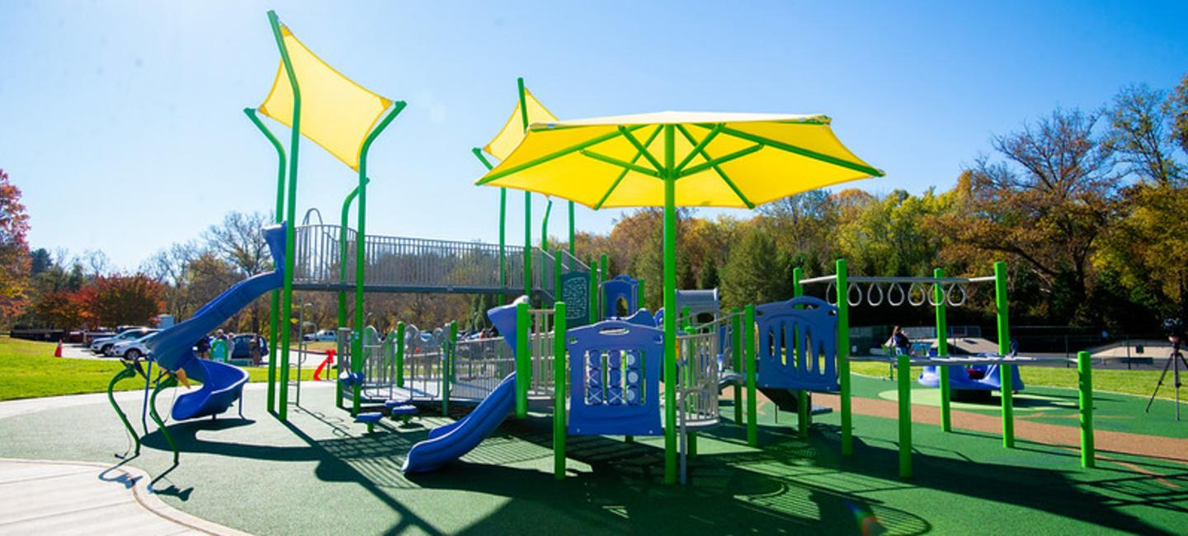
Supporting your child at home
Weekly drop-in sessions
Parent’s evening
Reports
Evidence Me
Learning together sessions
Weekly spellings will be set for your child on Spelling Shed. Children will get a ‘dip in the box’ if they access it 3 times a week.
Times Tables rockstars is popular with the children. Please ensure your child accesses it as much as possible as home. There are certificates to be won!
Reading at home is critical to a child’s development. If children read 3 times at home and their reading record is signed they will get a ‘dip in the box’.
Visit your local park regularly to support your child’s gross motor development i.e. balance, core strength etc.
Our school Phonic and Early Reading scheme is Little Wandle – In Year 2 we recap Phonics until October half term and then move onto Little Wandle spelling rules.

Slide 19
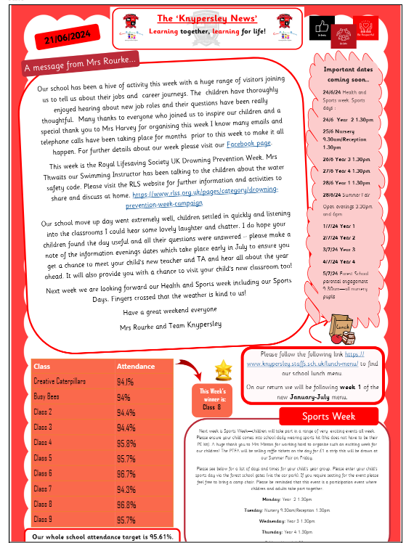
newsletter
All important information / dates will be on the newsletter.
You will be emailed this each Friday.
2. The World We Live In
https://www.knypersley.staffs.sch.uk/newsletters/

Slide 20
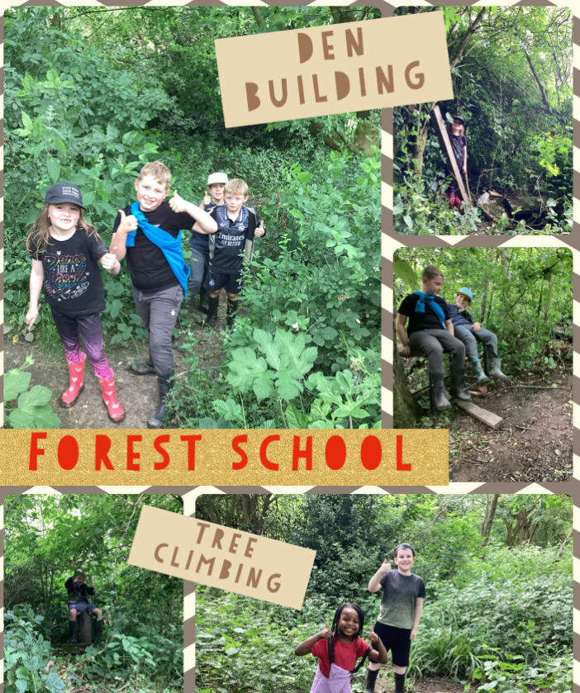
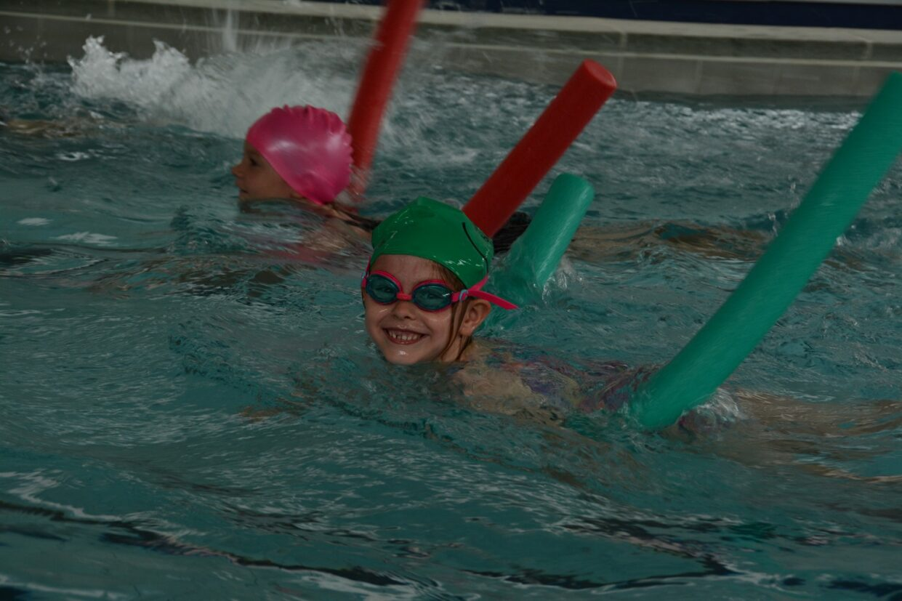
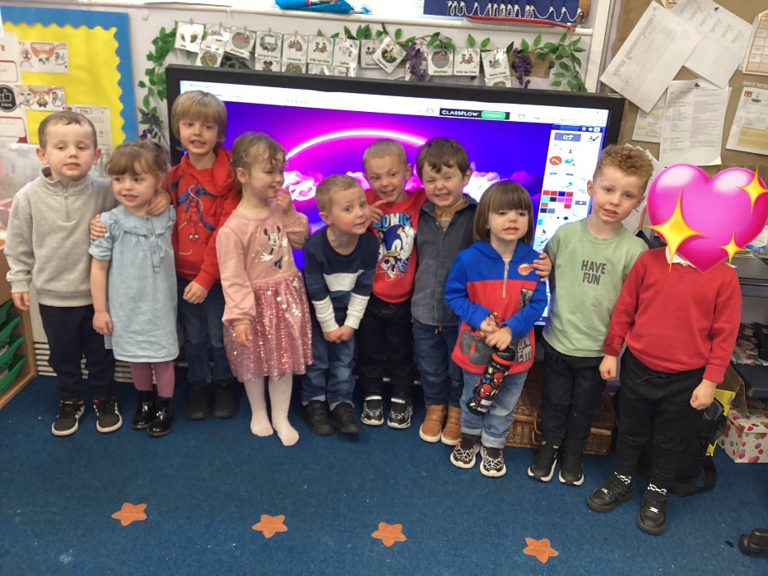
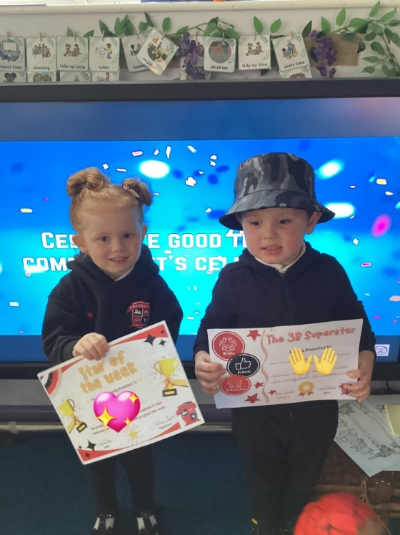
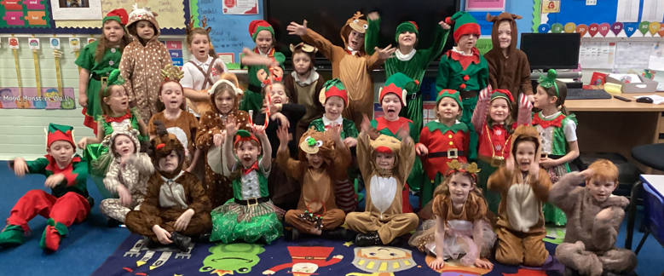
Exciting events
Pantomime!
Forest School
School disco!
Swimming
Celebration Assembly
School Trips
Change for Life Festival
Christmas nativity

Slide 22
Reminders
Please ensure that you have updated your child’s details with the school office if they have had a change of address or phone number or if they have developed an allergy. Please also check your child’s social media status is up to date as we now use Facebook to post pictures. Give us a follow! We will post pictures weekly.

Slide 23
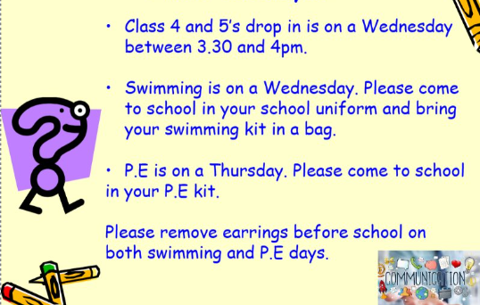
And finally

Slide 24
Thank You!
Do you have any questions for me before we go?

