Slide 1



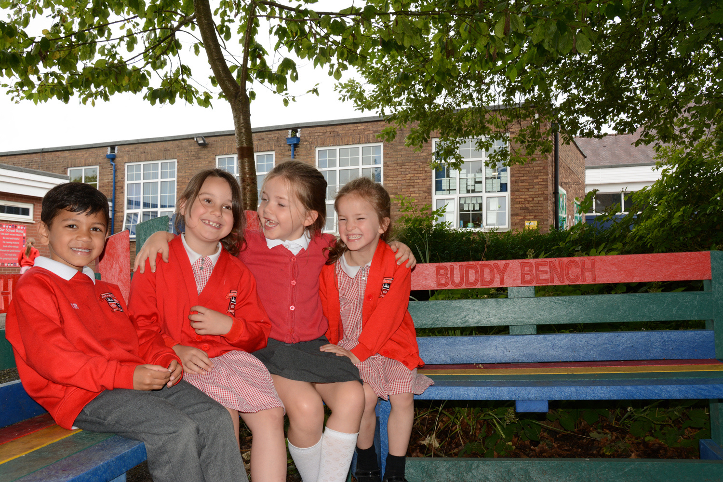



KNYPERSLEY FIRST SCHOOL
Welcome to Nursery
2024

Slide 2


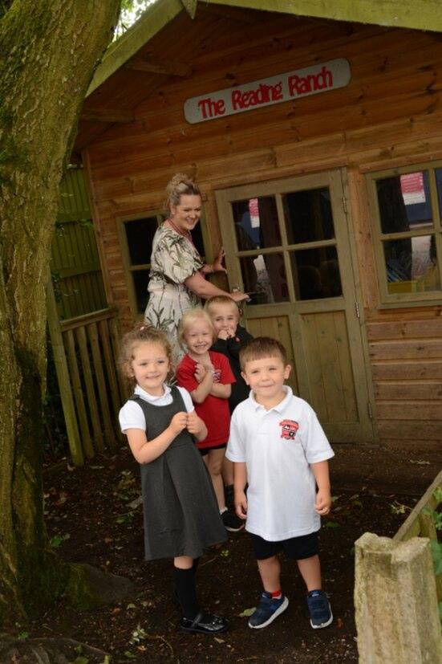





What We'll Discuss today
  School website
  Attendance
  Behaviour Policy
  Communication
  SEND support
  Yearly Overviews
  How to support at home
  Exciting Events
  Information Packs

Slide 3



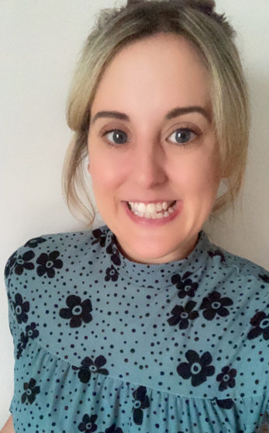
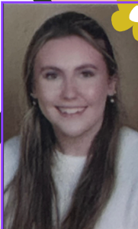
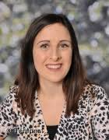


Introduction to The Nursery Team
Mrs Jones – Nursery Teacher
Miss Peers– Nursery Apprentice
Mrs Ellis – EYFS Leader

Slide 4




School Website
http://knypersley.staffs.sch.uk/
Policies
Newsletter - Online/ via Arbor (paper copies available via the school office).
E-Safety Guidance
Safeguarding page
PTFA information
School Calendar

Slide 5



Communication
We value your communication and feel that it is important that everyone feels heard and valued within our school community.
Below is an outline our the channels of communication within our school:
Arbor
Weekly Drop-in
Arbor is our main platform for direct communication for staff and parents. Arbor messages are check before school and after school by staff between the hours of 8:30-5:30pm. Mrs Taylor in the office checks Arbor frequently throughout the day. Please use Arbor for non-urgent messages, clubs and parent’s evening appointments.
Beyond the formal parents meeting events noted above, our school has always offered a night during every school week where staff are available to answer any questions you may have or to address any concerns which may have arisen. These sessions are between 3.30- 4p.m
Nursery drop-in will be on a Monday.
Main Office
Reports/ Parents Evenings.
Please call the school office 01782 973810 to pass on urgent time limted messages for example-informing us that your child is absent, booking your child into Kid Zone (due to an emergency). Please be mindful that this is NOT for non-urgent messages that could be passed on by staff at the door.
Reports are sent three times a year at the end of every term. Parent’s Evenings are then run twice a year at the end of Autumn and Spring half terms in order for staff to inform you of successes and next steps.
Parent’s evenings can be book via Arbor.

Slide 6
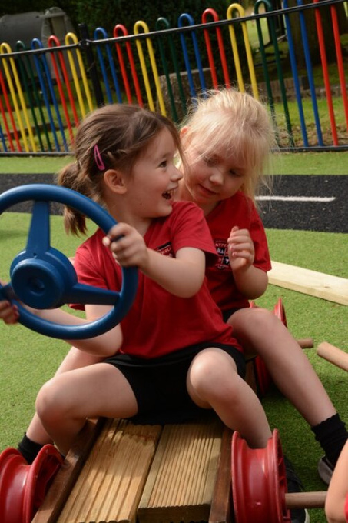


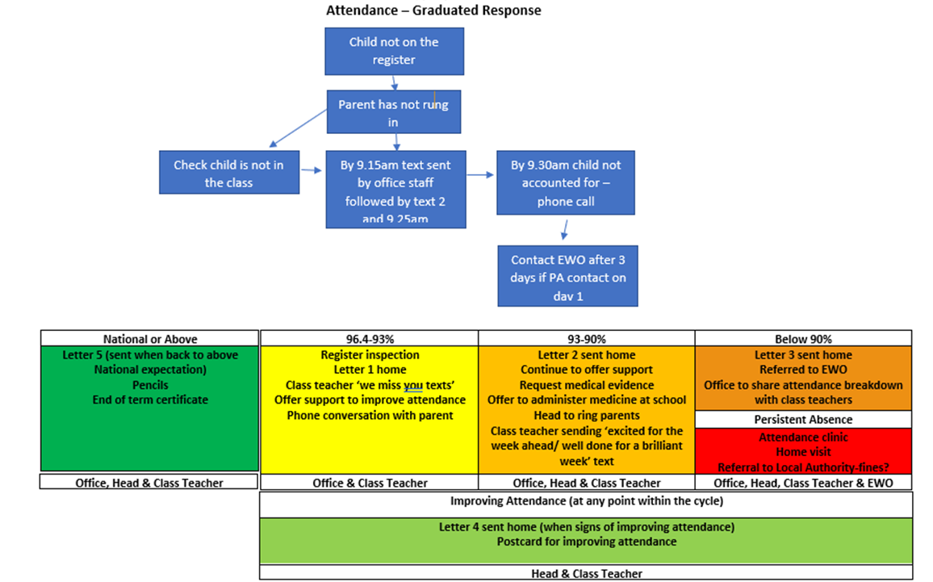



Attendance
Attendance is tracked daily
It is of the up-most importance that you report absences. This is to support our safeguarding procedures
Forming good habits
Supports progress
Increased wellbeing
Supports to build friendships
Holiday request forms can be collected from the school office. We encourage you to avoid taking holidays within school time.

Slide 7




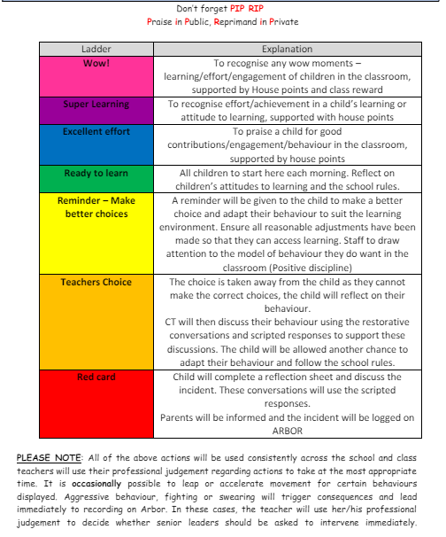

Positive behaviour management
https://www.knypersley.staffs.sch.uk/wp-content/uploads/2023/08/Knypersley-Positive-Behaviour-Policy-23-24-5.pdf
Our 3B rules are consistent from nursery to Year 4 which supports children in understanding expectations for behaviour.
Each class starts the year by writing their own class 3B expectations which develop over the years as they do themselves.
Our Positive Behaviour Policy is based upon restorative conversations and practice. Ensuring all children use mistakes as a chance to learn and better themselves.
Parents are notified if their child reaches a ‘red card’. This will mean that your child has needed multiple reminders and have not been able to follow the 3Bs over a period of time.
If your child reaches ‘WOW’ this is down to them following the 3B expectations conssitently enough to reach a reward. Moving to WOW is not done due to a one off event or learning achievement.

Slide 8






Class Webpages/ Curriculum overviews
Our year group page hosts a wealth of information that staff refer to throughout the year such as:
  Curriculum Overviews - Overview of learning over the year. This is a great way to pre-teach or to engage with learning theme's as your child is immersed within them in school.
  Class Webpages
  Curriculum drivers i.e. Careers Week, Faith in Focus Etc.
2. The World We Live In

Slide 9
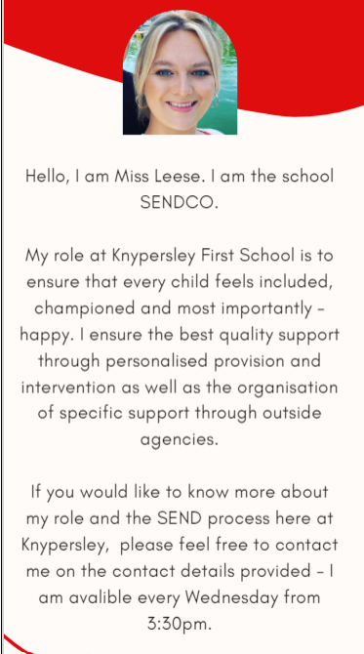
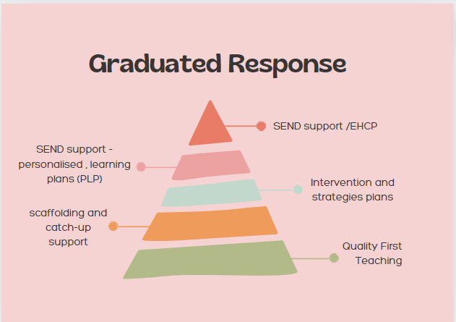

SEND support AT Knypersley First School
https://www.knypersley.staffs.sch.uk/special-educational-needs-and-disabilities/

Slide 10
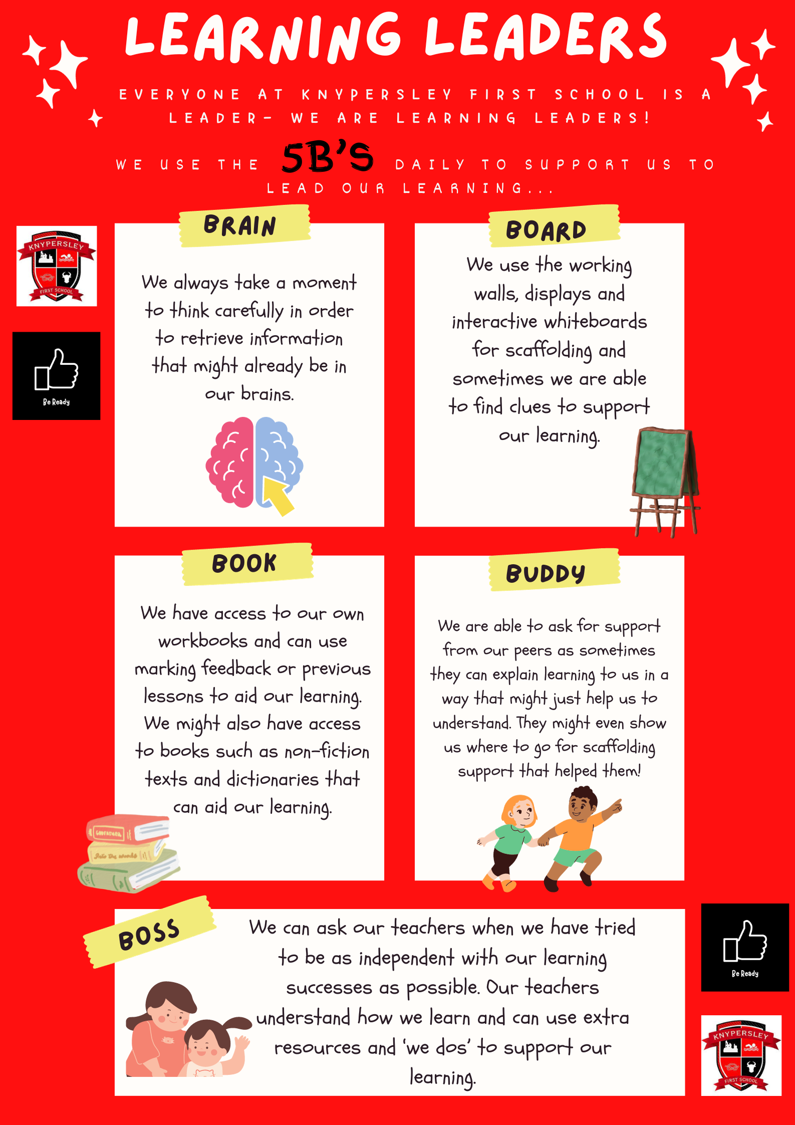
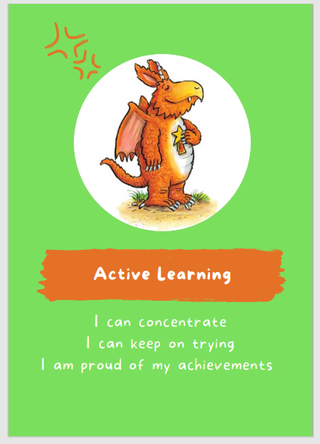


Behaviours for learning
2. The World We Live In

Slide 11



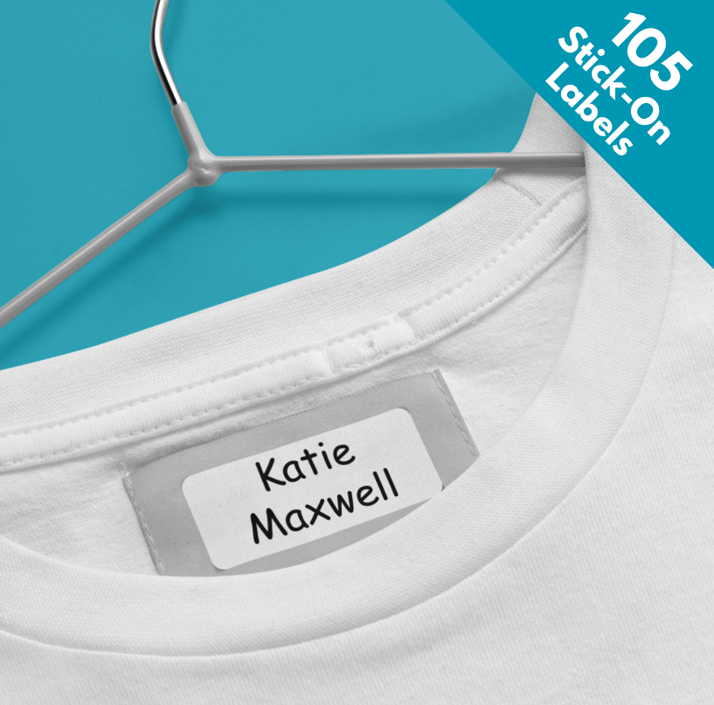
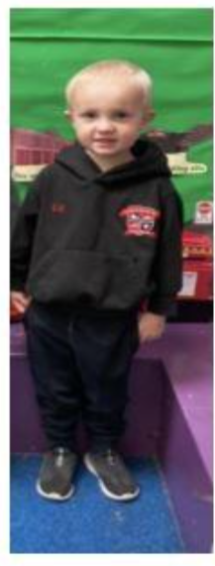
Nursery Essentials
We are a healthy school and promote water in bottles and healthy lunchboxes. Please speak to a member of staff if you require support with this.
We are a nut free setting due to allergies identified. Thank you for your support with this.
Please can all medication be signed into school via the main office. No medicine will be accepted on the door.
EYFS Uniform:
Black Sports Jumper
Red Polo Top
Black Jogging bottoms/ Leggings
Black Velcro Trainers
All uniform is required to be the same therefore items can be swapped or misplaced. Please support staff in returning items by clearly labelling all items including bottles, hats, coats etc.

Slide 12
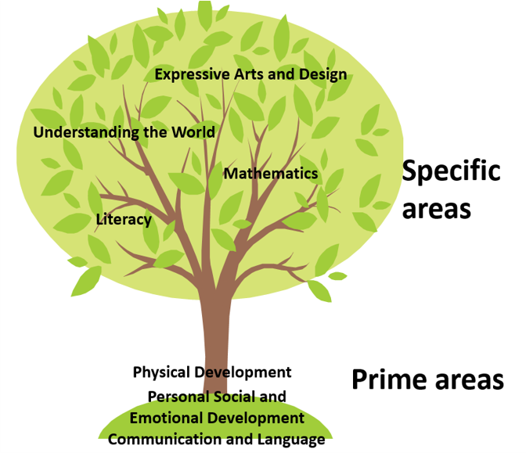
Nursery Throughout the Year
https://www.knypersley.staffs.sch.uk/nursery/
2. The World We Live In

Slide 13
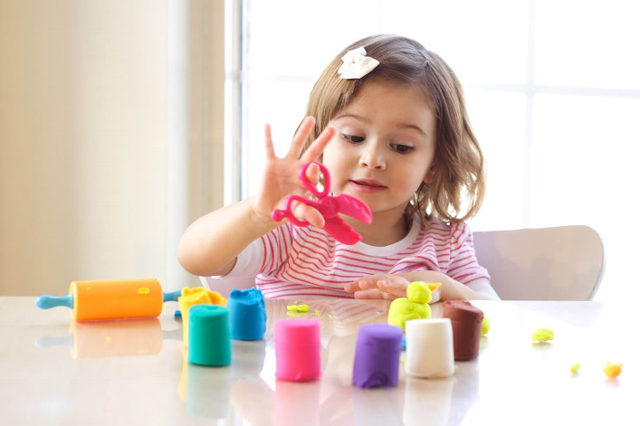


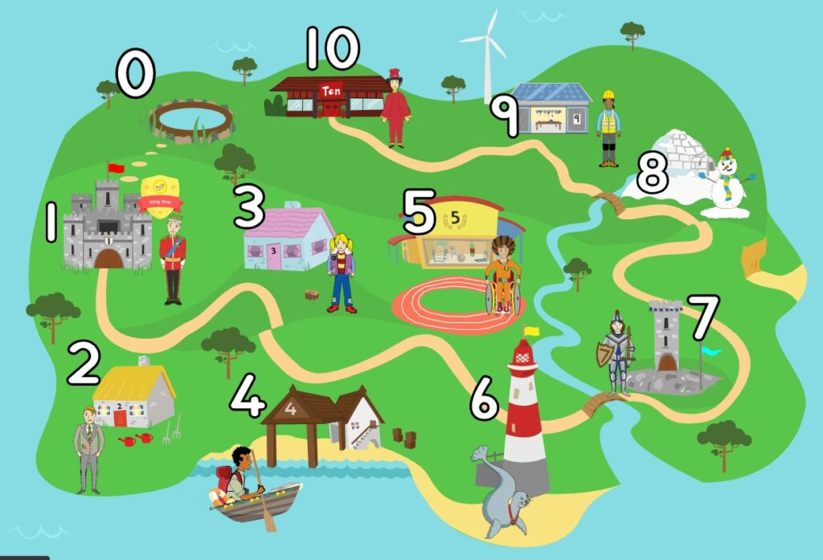
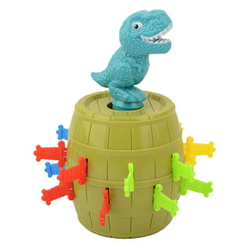

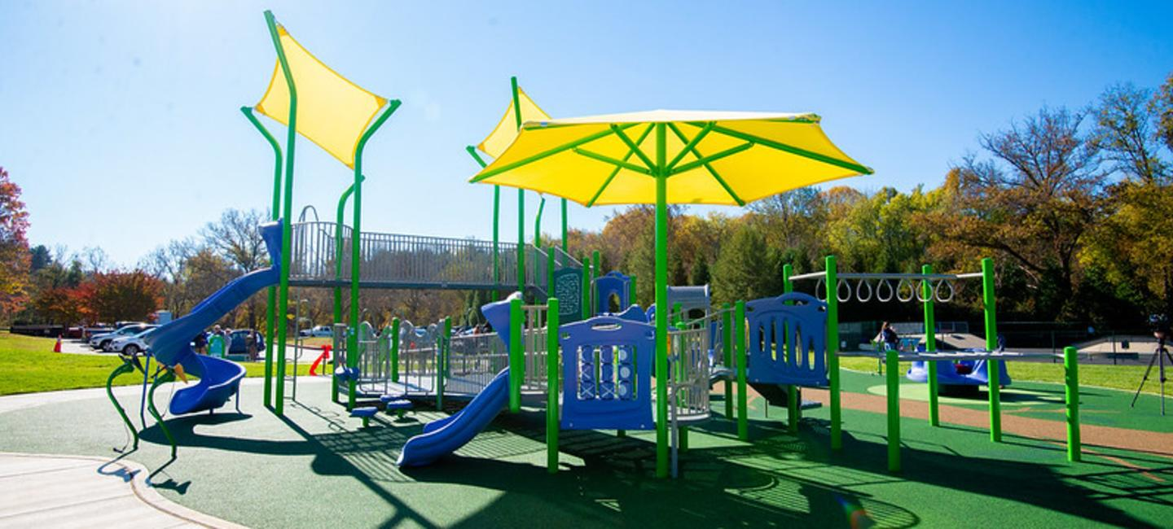
Supporting your child at home
https://www.knypersley.staffs.sch.uk/nursery/
Weekly drop-in sessions
Parent’s evening
Reports
Evidence Me
Learning together sessions
Dough Play will support your child’s fine motor development – Youtube ‘Dough Disco’
Ten Town – Introduction to numbers
Playing games with your child will support with personal and emotional development.
Visit your local park regularly to support your child’s gross motor development i.e. balance, core strength etc.
Our school Phonic and Early Reading scheme is Little Wandle – In Nursery we follow the Foundations of Phonics to promote listening and pronouncing sounds.

Slide 14
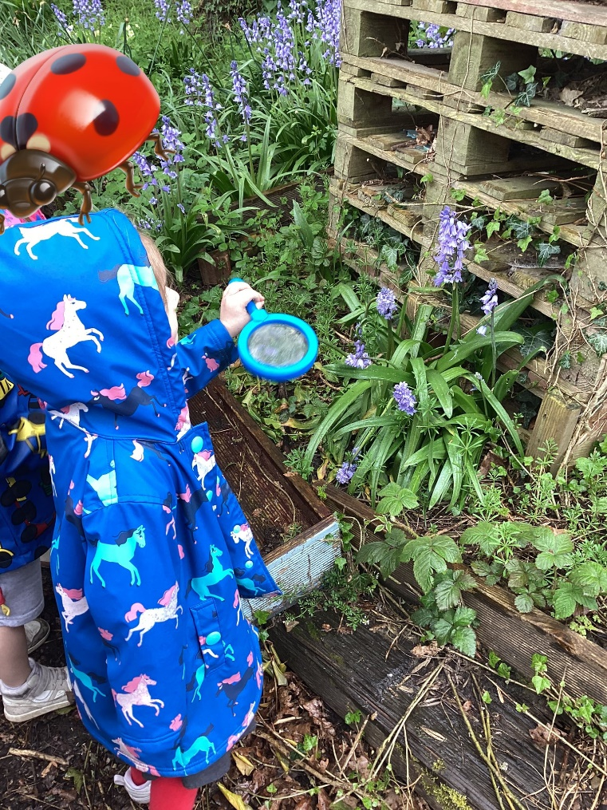
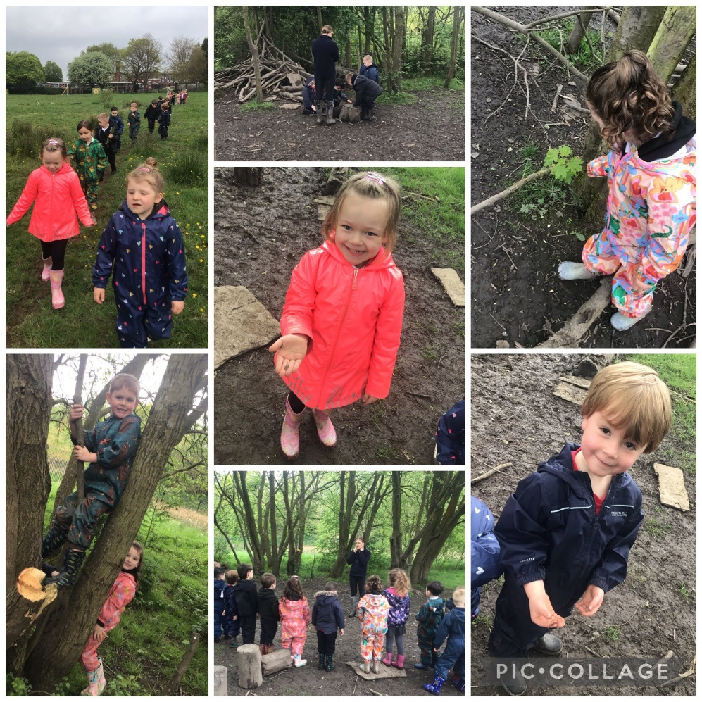
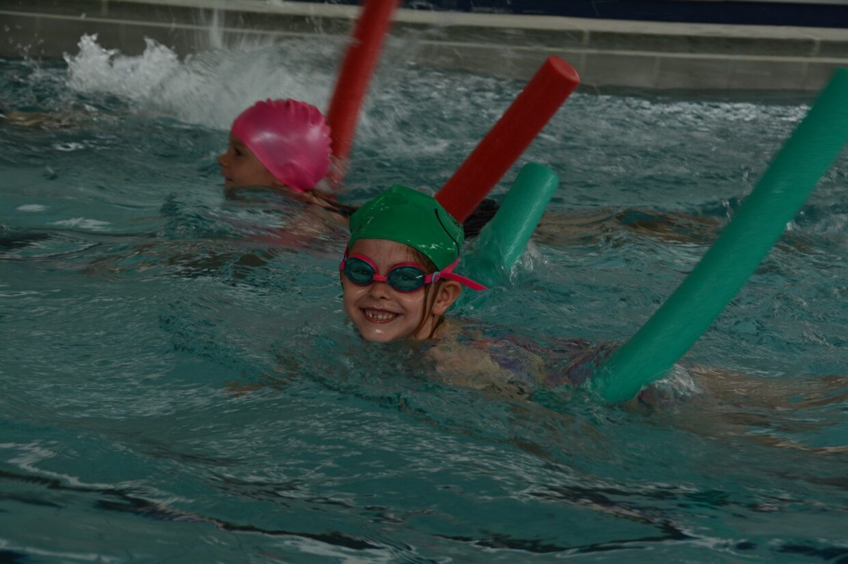
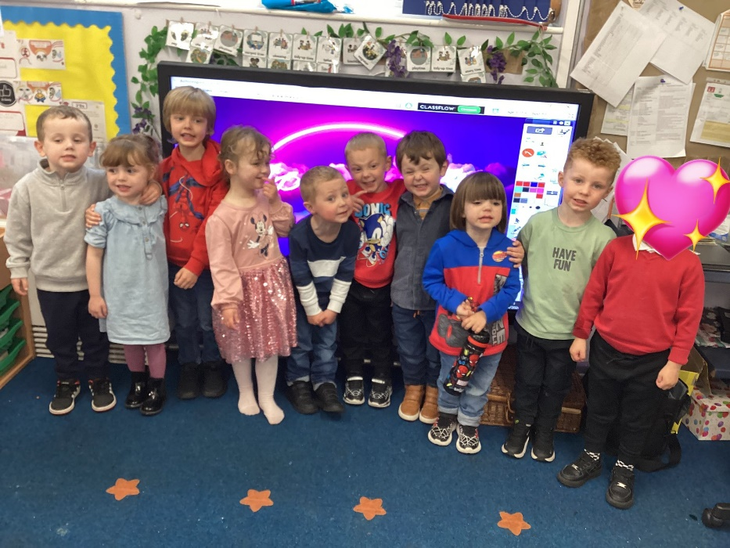
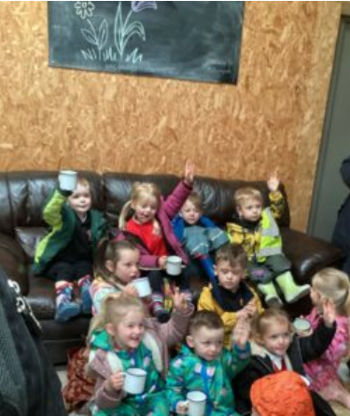
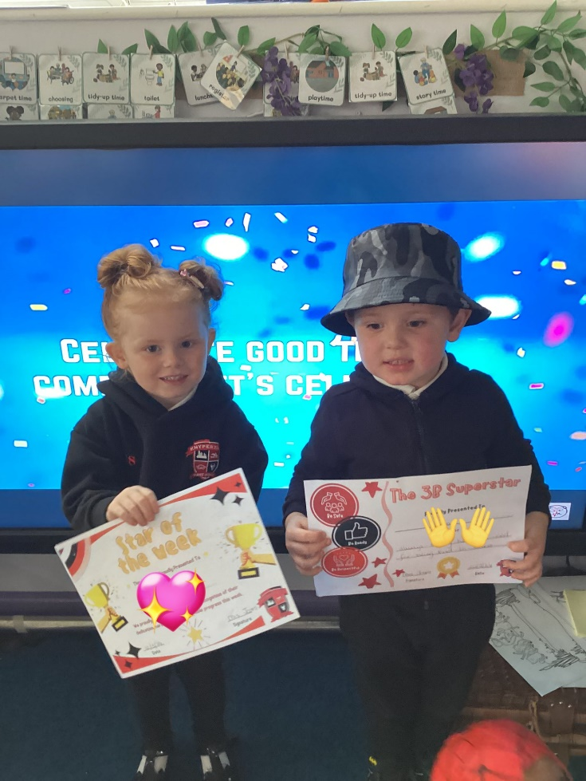
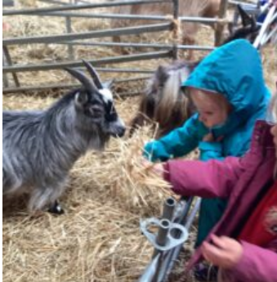
Exciting events
Outdoor Explorers
Forest School
School disco!
Swimming
Celebration Assembly
School Trips

Slide 15
Information Packs
Please ensure that before June 20th (Transition Day)
You have returned forms within the Welcome To Pack that you will be given tonight.
This is to ensure that we have all details to support your child to stay independently for the session.

Slide 16




Thank You!
Do you have any questions for me before we go?

