Slide 1
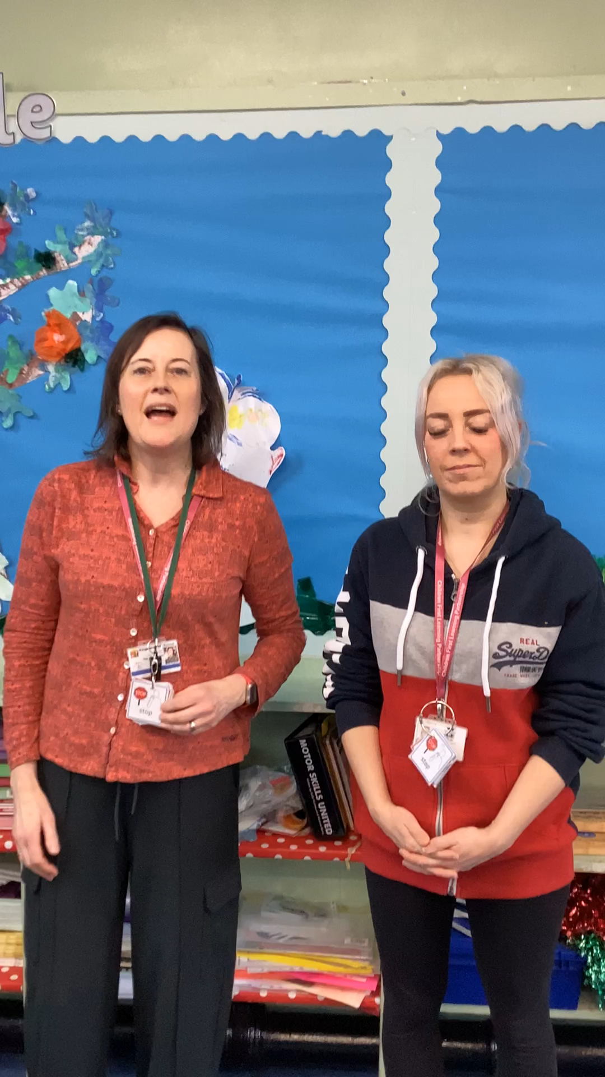


Mrs Sandbach and Ms Edge
Kingsfield First School, CFLP

