Slide 1

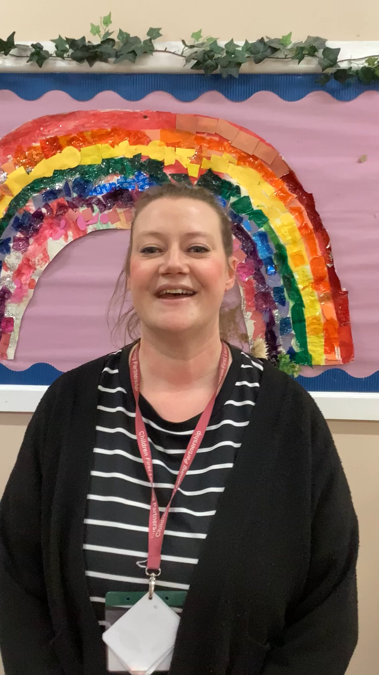

Mrs Duda
Knyperlsey First School
CFLP

