Slide 1


EYFS Curriculum Workshop
Supporting Learning at Home Workshop – 21st September 2023

Slide 2


Development Matters

Slide 3
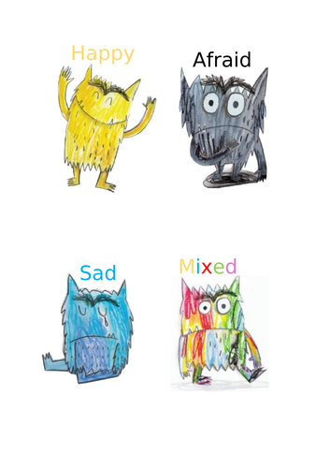



Personal, Social, Emotional Development
How we respond to our feelings and other people’s feelings.

Slide 4
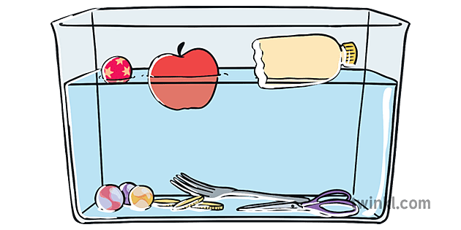
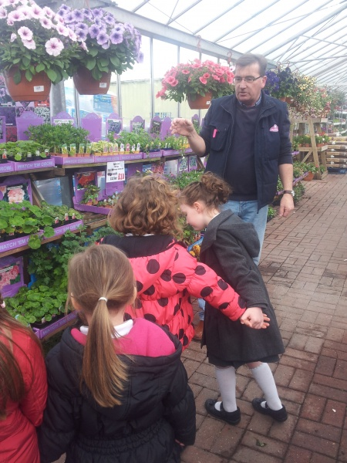



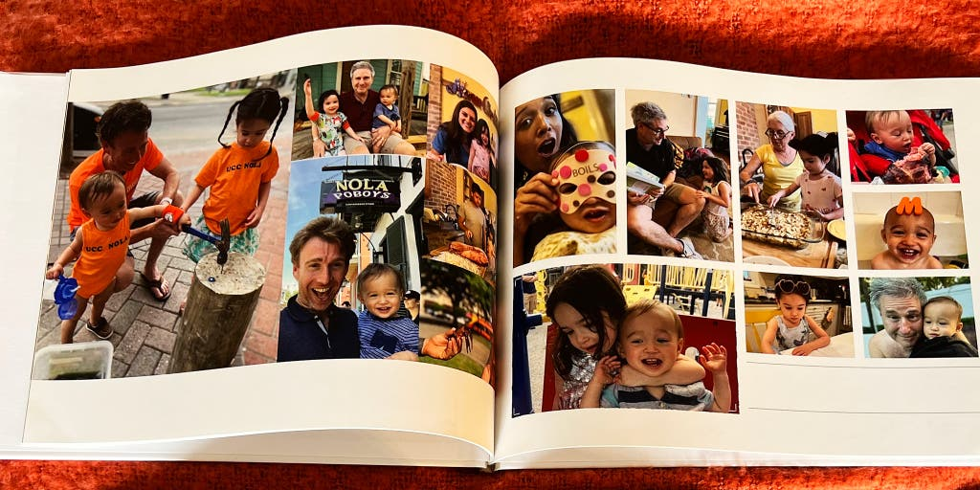
Understanding the World
Our main driver for the EYFS curriculum –
Myself and My World
Growth and Change
My World – Near and Far

Slide 5
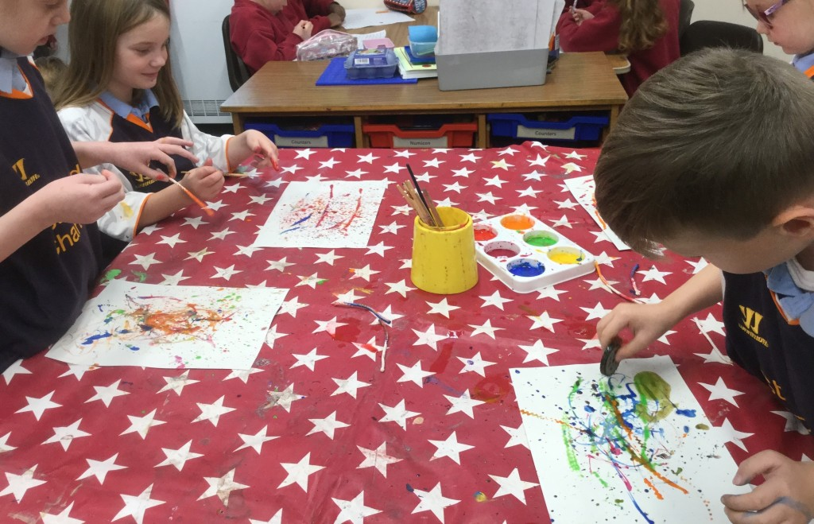
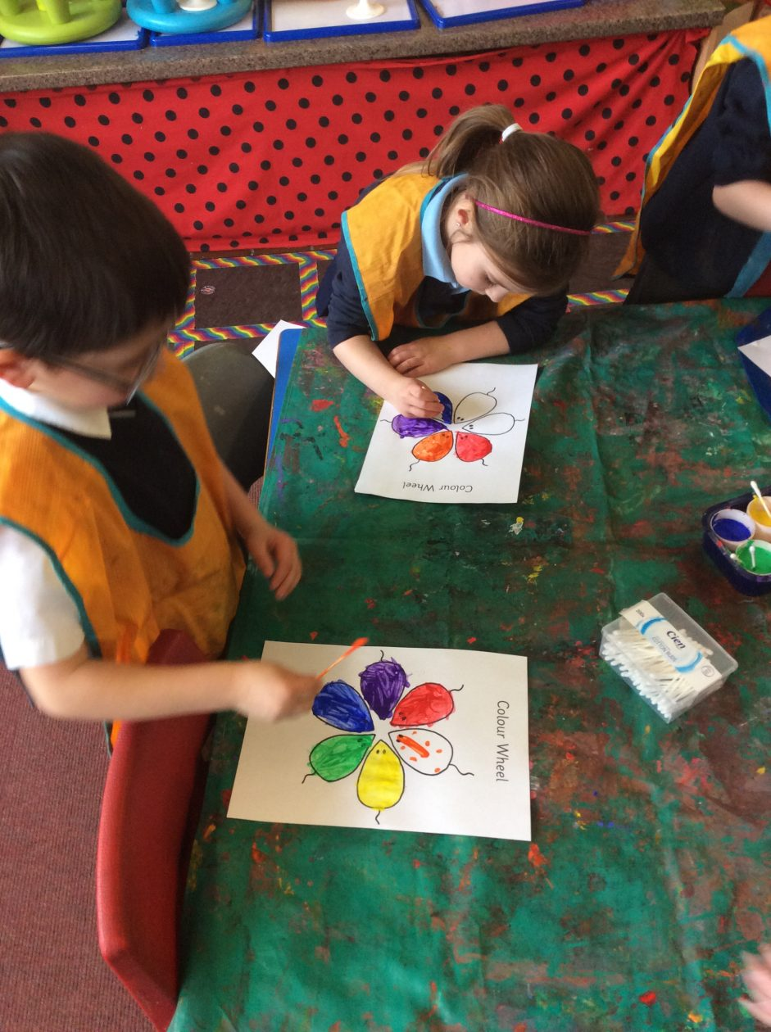




Expressive Arts and Design
‘EAD’ covers subject areas such as Art, DT and performance

Slide 6

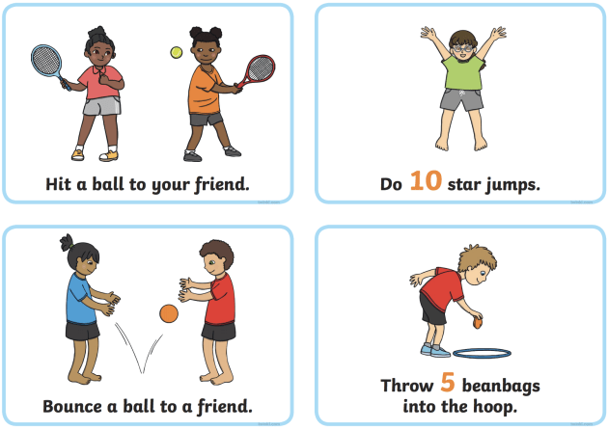

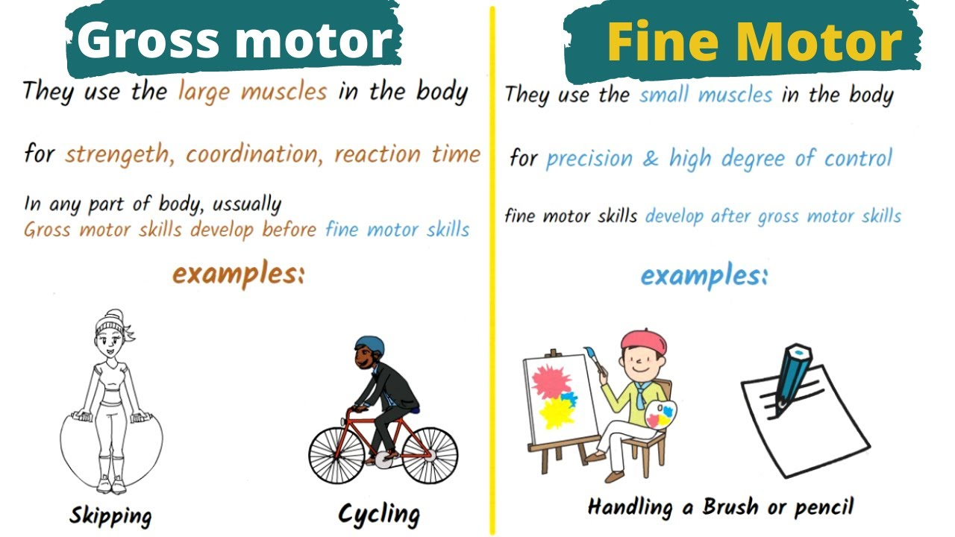

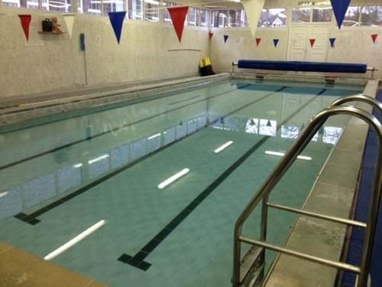
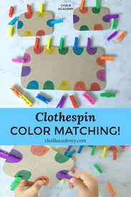
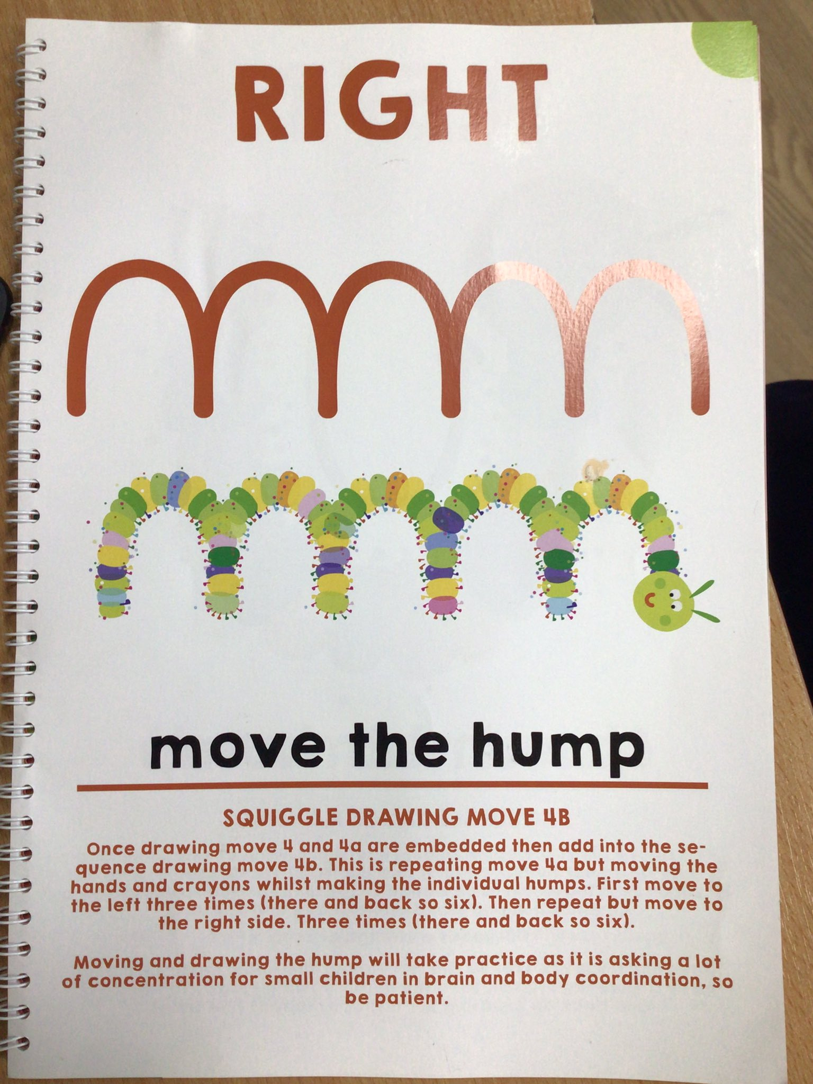

Physical Development
Balance, agility, core strength, co-ordination

Slide 7

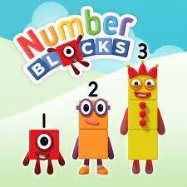


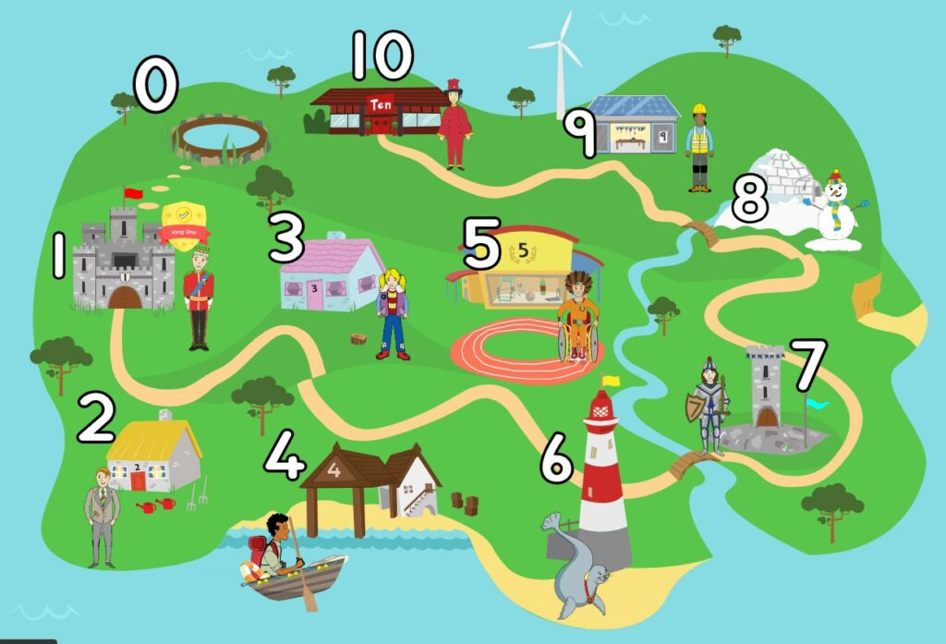

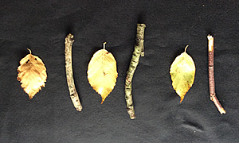
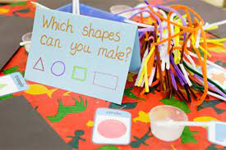
Mathematics
Ten Town
Maths Mastery – NCTEM (Reception)

Slide 8

The foundations of reading…is phonics!

Slide 9

Early Years = Pre-Reading Skills
These are incredibly important!
1st. Speaking and listening skills done with our ears
2nd. Children are provided with solid foundations ready for ‘reading with our eyes!’
These next slides will take you through step by step of a child’s reading journey…

Slide 10

Nursery – ‘Foundations for Phonics’
Tuning into sounds
Distinguishing between different sounds
Listening & Attention games
Knowing how to hold and use a book.
Notes:
Starting with nursery.
Will break these down over the next few slides to explain what this looks like and how you can help at home.

Slide 11
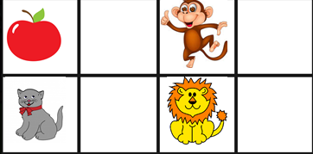


Hearing initial sounds
The 1st sound in a word. Alliteration games.
1.
With visual pictures, parent modelling separating the initial sound from the word.
C-C-C-C-C cat
2.
With visual pictures, parent says cat and child
recognises c as the initial sound.
3.
I spy style games. Can you see something that starts with a c? Or what sound does cat start with but without the visual.

Slide 12
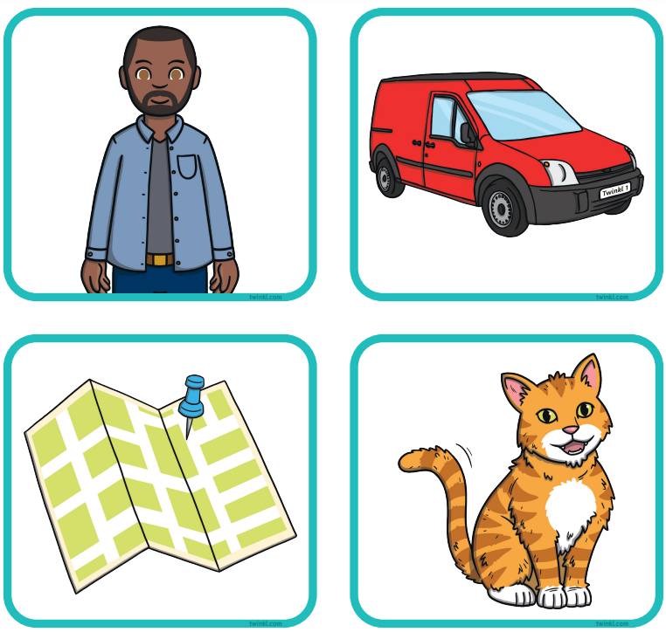

Oral Blending
Blending is the process that is involved in bringing the sounds together to make a word or a syllable and how /c/ /a/ /t/ becomes cat.
Step 1.
With pictures/objects in front of them can they point to the
c-a-t?
Step 2.
Hide the pictures/objects and ask your child to see if they can guess what it is.
I am hiding a c-a-t. What is it?

Slide 13


Oral Segmenting
Breaking the word up into the sounds that make it.
p-i-g
d-o-g
t-a-p

Slide 14

Reception Phonics
Phase 2 -Single letter sounds s,a,t,p,i,n
Reading CVC words pig, cat, lip
Phase 3- digraphs and trigraphs sh & igh
Reading words with those sounds
Phase 4- longer words
Daily phonics lesson
3 reading practise sessions a week where secure phonic knowledge is used to read a book matched to your child’s knowledge.
Notes:
Progression through reception

Slide 15
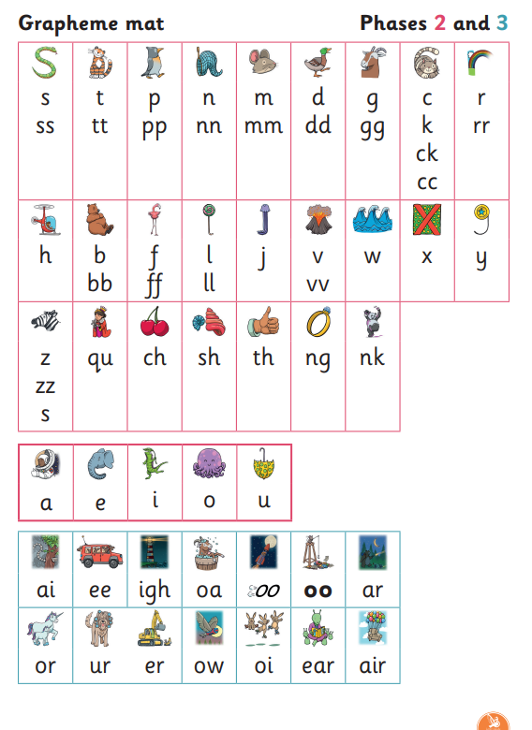
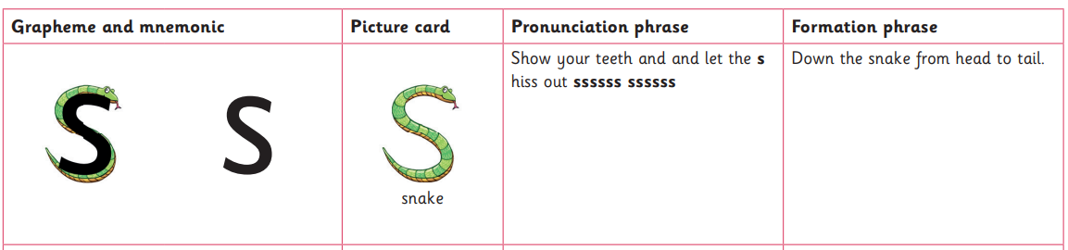
Pronunciation phrase for each sound
Formation phrase for writing.
All available via a link on the Reception webpage.
Notes:
These are all of the sounds that chn in Rec. will be taught.
-pronunciation phrase
-formation phrase
All available on on website.

Slide 16



Tricky Words
They are tricky because they cannot be sounded out, there is a tricky bit in the word. E.g. the, was, so….
Children in Reception start to learn these words and they will continue to learn new common exception words right through into KS2.

Slide 17
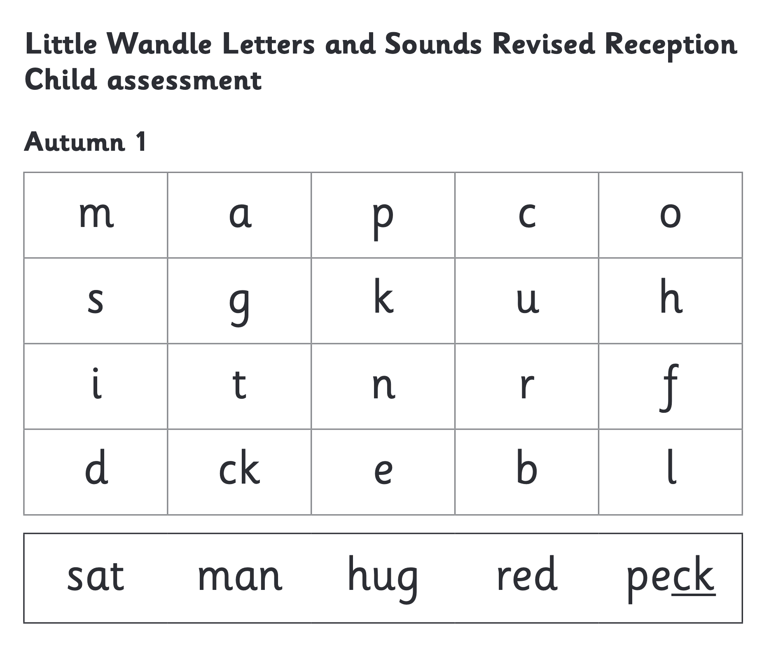
We use assessment to match your child the right level of book
Every 6 weeks children will be assessed
Notes:
We assess your child every six weeks to check progress. Any child who needs extra support has daily keep-up sessions planned for them.
3 reading sessions
1- decode
2-prosody (discuss vocab & link to meaning, photos and experiences.
3- comprehension- understanding what has been read and answering questions. (PROMPTS for this at home @ back of book)

Slide 18
Reading at home
Library Book (all)
Phonics pack - for you to do with your child. They will need your support to play it. Instructions will be with the pack (reception and nursery when ready)
Decodable book (reception)

Slide 19
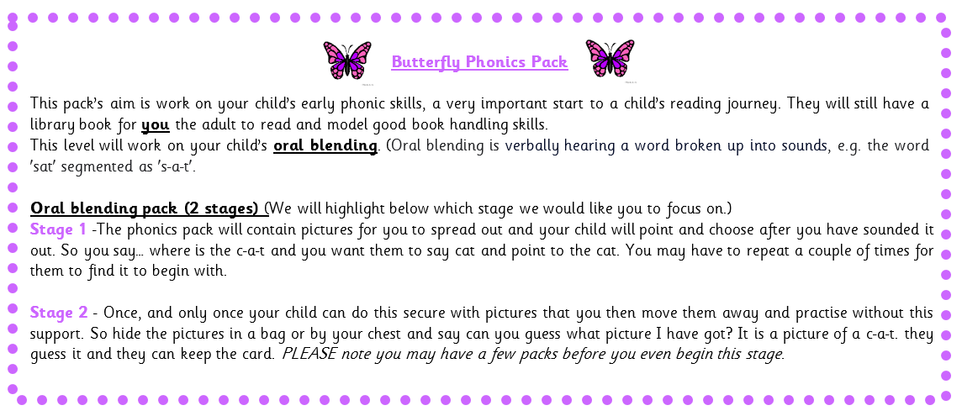
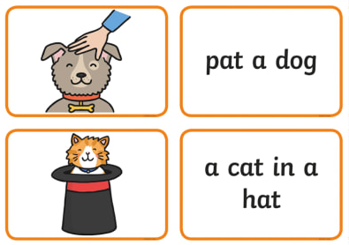
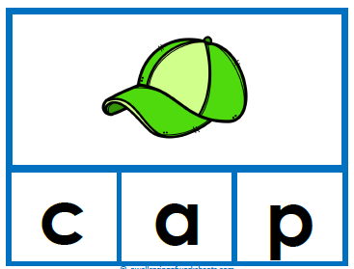
Phonic Packs
For Reception children and Nursery when they are ready.
Matched to child’s need and used as a resource at home to secure
Oral blending (2 stages)
Initial sounds
CVC word readings
-Caption reading
Parent support guidance provided.

Slide 20

Any Questions?

